Slide 1


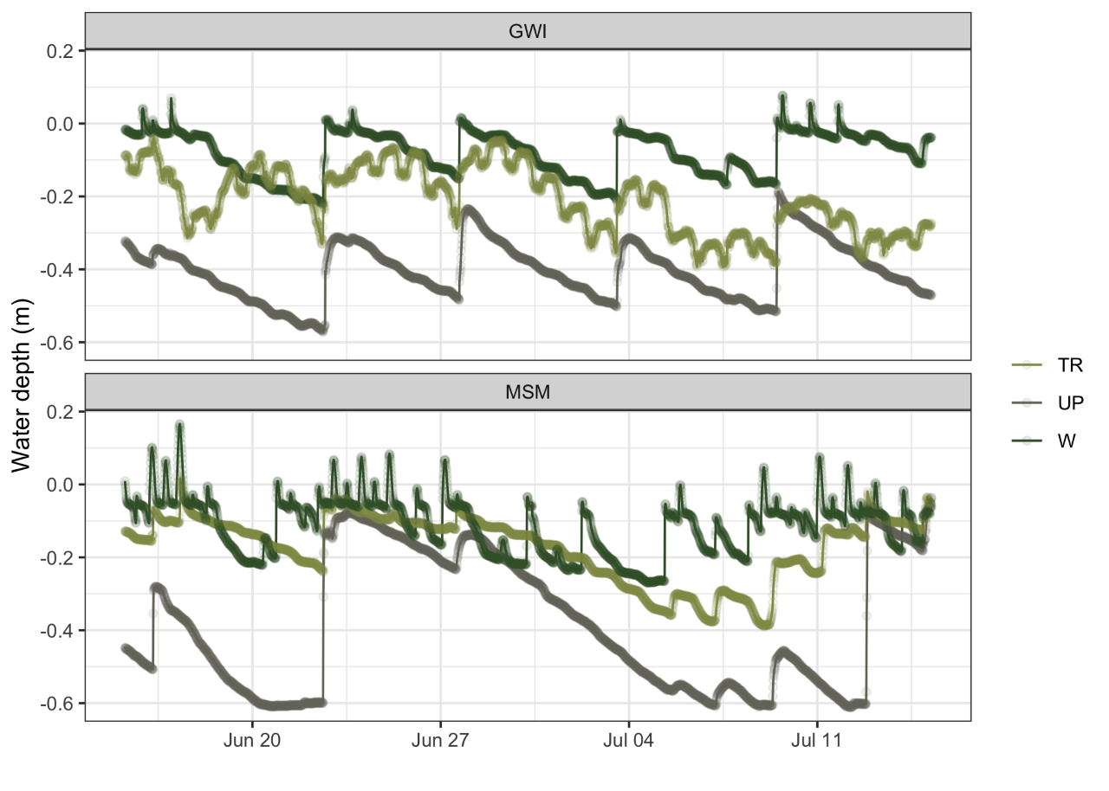
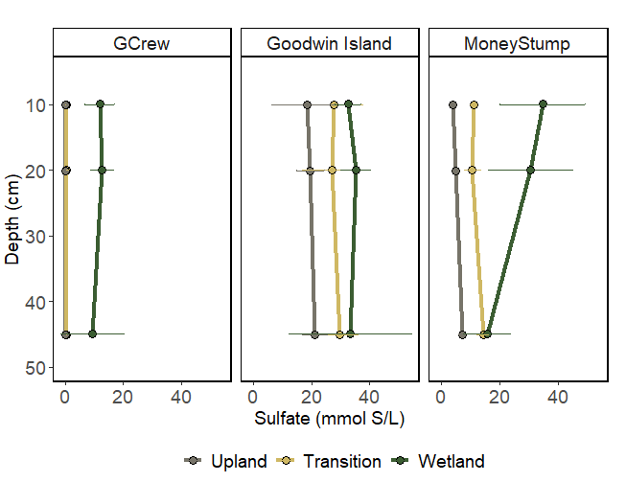
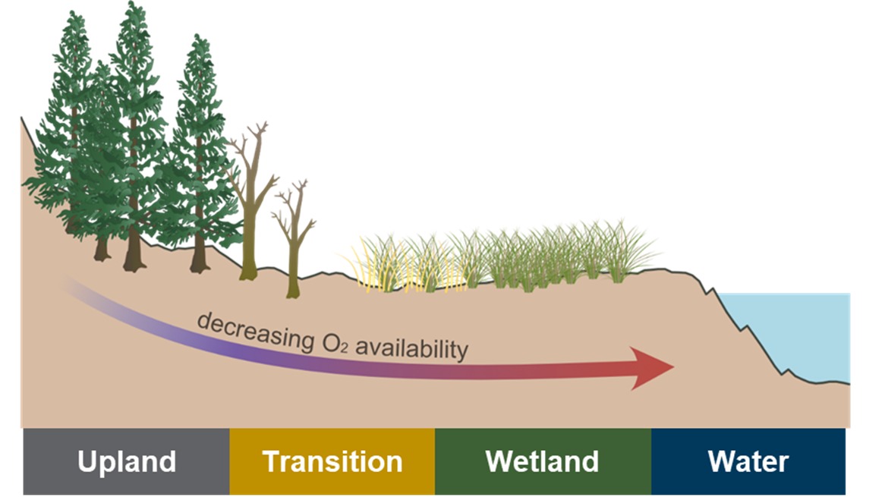
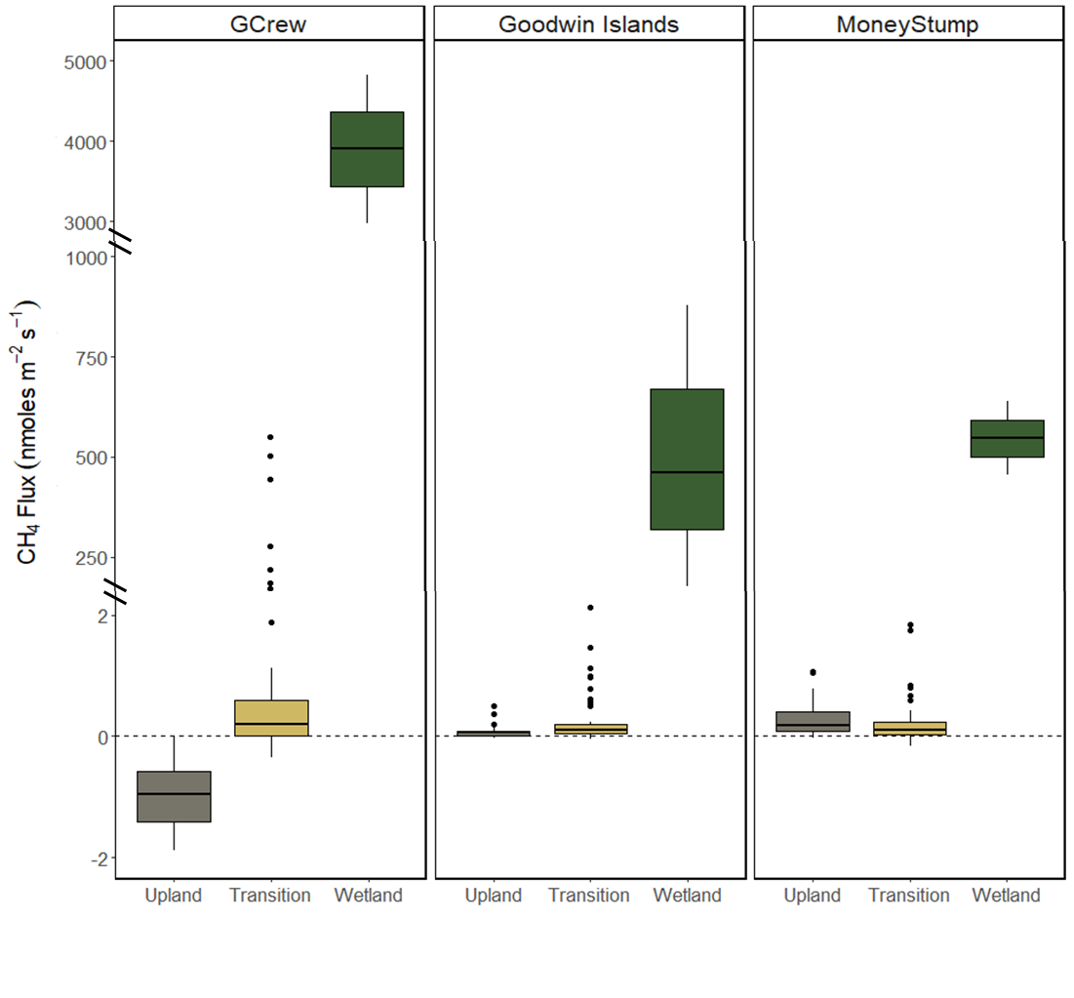
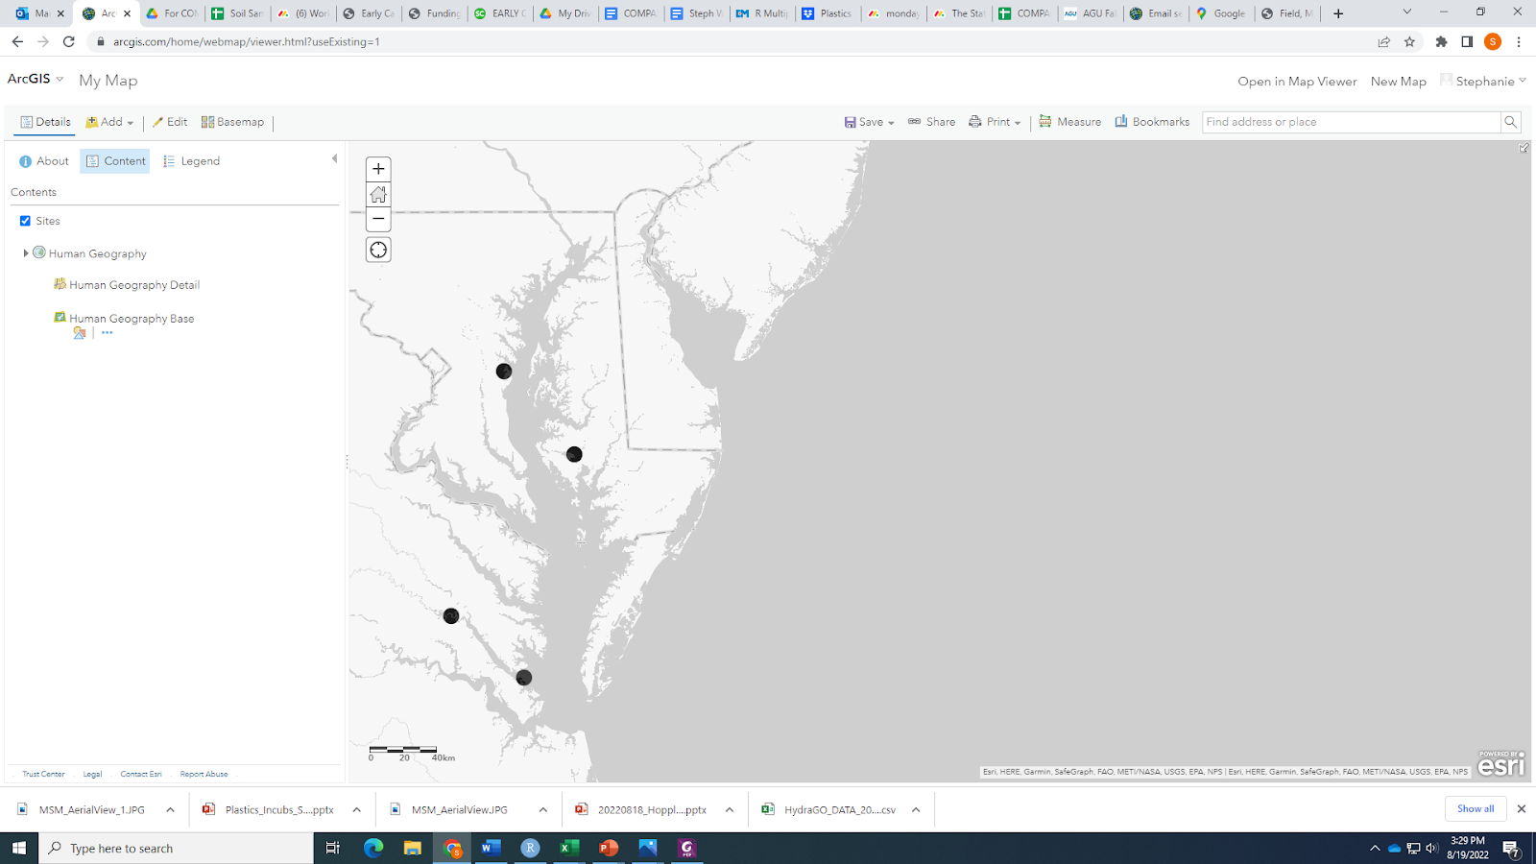

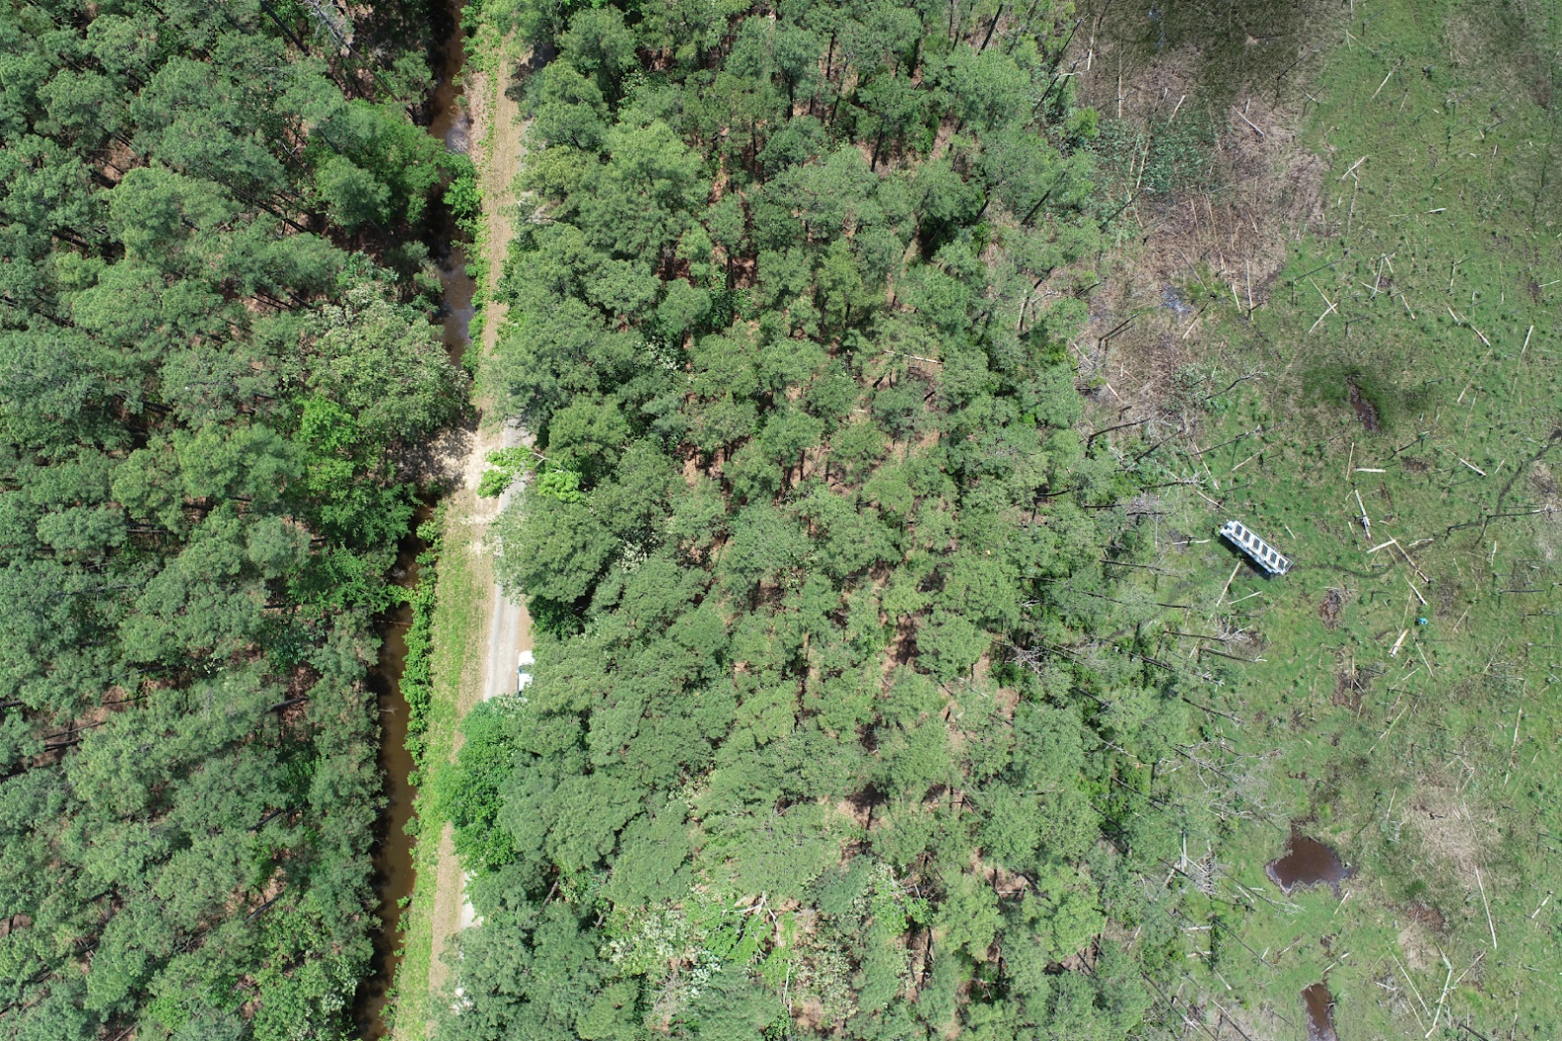
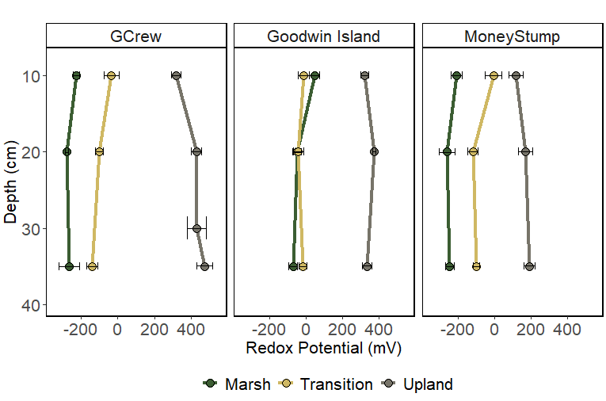
Beneath the Ghost Forest: Biogeochemistry and Function in Soils as they Transition from Coastal Forest to Wetland
Stephanie J Wilson¹, Patrick Megonigal¹, Roy Rich¹, Alice Stearns¹, Evan Phillips¹, Erin Fien¹, Lani DuFresne¹, Peter Regier², Allison Myers-Pigg², Stephanie C Pennington³, Anya Hopple¹, Kendalynn Morris⁴, Nathan McDowell⁵, Ben P Bond-Lamberty⁶, Michael N Weintraub^{7,8}, Nicholas D Ward⁹, Ken M Kemner¹⁰ and Vanessa L Bailey¹¹
(1)Smithsonian Environmental Research Center Edgewater, Edgewater, United States, (2)Pacific Northwest National Laboratory, Sequim, United States, (3)University of Maryland College Park, College Park, United States, (4)Pacific Northwest National Laboratory, College Park, United States, (5)Pacific Northwest National Laboratory, Richland, United States, (6)Pacific Northwest National Laboratory, Joint Global Change Research Institute, College Park, United States, (7)University of Toledo, Environmental Sciences, Toledo, United States, (8)Pacific Northwest National Laboratory, Biological Sciences Division, Richland, United States, (9)Pacific Northwest National Laboratory, Richland, WA, United States, (10)Argonne Natl Lab, Argonne, United States, (11)Battelle PNNL J4-18, Richland, United States
GC42J-0826
wilsonsj@si.edu
@stephscience
Background:
Sea level rise drives spatial migration of coastal ecosystems and can lead to the replacement of coastal forests with tidal wetlands.
Stressed or dead trees are well-recognized indicators of the conversion of forest to wetland, but carbon cycling and soil biogeochemistry are also altered significantly during this transition.
Changes in soil biogeochemistry and vegetation during marsh migration may occur on different timescales and could influence ecosystem function.
Results
Gradient in water level across zones
Hydrologic conditions also vary across sites
Transition sites are highly variable
This variability drives biogeochemical hot spots and hot moments
Porewater sulfate concentrations directly linked to salinity and conductivity
Profiles across zones match hydrology and soil moisture
Methods:
Fig.3. Porewater sulfate concentrations at GCReW, Goodwin Islands, and MoneyStump across zones.
Site | Salinity
Sweethall | 0-2
GCReW | 8-10
MoneyStump | 8-10
Goodwin Islands | 18-20
Fig.1. Water level overtime at Goodwin Islands and MoneyStump across zones.
Soil function with respect to CH₄ is shifting prior to mass tree mortality
Observed across site salinities and following hydrologic gradient
Supporting that inundation may be more important to ecosystem function with respect to CH₄
Hypothesis: There is a hierarchical structure to spatial variation in ecosystem structure and function at the coastal terrestrial-aquatic interface set by:
1) the depth and duration of soil saturation
2) the abundance of redox-sensitive elements
3) their interactions with plant traits
GCReW
Money Stump
Sweethall
Goodwin Islands
Lower redox potential suggests more reducing conditions
Trends across zones align with soil moisture and water level
Horizontal and depth gradients driven by hydrology and soil moisture
Fig.4. Soil CH4 fluxes at GCReW, Goodwin Islands, and MoneyStump across zones. Measured with Licor LI-7810 and Licor Smart Chamber.
Upland
Transition
Wetland
Take home messages:
Inundation depth and duration are a major drivers of structure and function at the coastal terrestrial aquatic interface
Changes in soil biogeochemistry and vegetation during marsh migration occur on different timescales
This asynchrony will influence ecosystem function and is critical to the framework to how we will accurately model these systems
Continuous monitoring of water level and soil moisture across terrestrial-aquatic interface in the Chesapeake Bay.
Monthly redox profiles, porewater samples, and measurements of soil greenhouse gas fluxes across upland, transition, and wetland zones.
Fig.2. Redox potential profiles at GCReW, Goodwin Islands, and MoneyStump across zones.
Notes:
NOTE: Print this poster file at 200% SCALE to result in a physical print measuring 72” wide x 48” tall. All type size notations shown above are based on the final printed size of the poster.
• Contact Digital Duplicating (375-2969, http://digitalduplicating.pnl.gov) to order poster printing and finishing services for your completed poster design.
• Remember to have your poster cleared for public display/distribution through the ERICA Information Release system (http://erica.pnl.gov).
• Sidebar “About PNNL” box is considered optional, and can be removed if space is needed for technical content.

